Slide 1
Microeconomics
^{SHORT RUN & LONG RUN COSTS}

Slide 2
Short Run Costs
Total Quantity | TC
0 | 180
1 | 300
2 | 400
3 | 510
4 | 720
5 | 1000
For the given data,
Calculate
TFC, TVC,
AC, MC,
AFC, AVC
Plot the Graph.

Slide 3
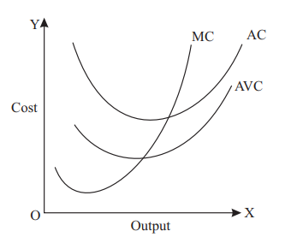
Short run Cost Curves
AC – Cup shaped Curve
MC – Nike Curve
MC cuts AVC at the minimum
Relationship between AC and MC
(i) When MC is less than AC, AC falls with increase in the output
(ii) When MC becomes equal to AC, AC becomes minimum and constant.
(iii) When MC is more than AC, AC rises with increase in the output

Slide 4
Analysis of Revenue & Cost Curves:

